Slide 1
Flipkart Reviews Sentiment Analysis
DHILNA MD
MCA II
ROLLNO:17

Slide 2
Introduction
Dataset Overview
Data Preparation
Data Visualization
Model Selection
Model Evaluation
Model Comparison
Prediction Example
Conclusion

Slide 3
Flipkart Review Analysis
It involves analyzing customer reviews from Flipkart to understand customer opinions and sentiment about a product. This process helps companies make data-driven decisions to improve products, understand customer satisfaction, and develop better marketing strategies. This simple analysis helps identify customer sentiments and highlights areas where a product might need improvement. It can be scaled to analyze thousands of reviews, offering valuable insights into product performance and customer satisfaction.

Slide 4
Sentiment analysis
Sentiment analysis means extracting, identifying, or classifying sentiment from text using natural language processing. It is also known as opinion mining. It is a process of determining the sentiment or emotional tone behind a piece of text. It aims to classify text into predefined sentiment categories, such as positive, negative, or neutral.
Sentiment analysis uses natural language processing (NLP), text analysis, and computational linguistics to identify subjective information in the text. It helps organizations understand the emotional response or opinion expressed in customer feedback, social media posts, or reviews.

Slide 5
Problem Statement:
Problem:
To analyze and understand customer feedback on Flipkart products by applying sentiment analysis techniques. The goal is to classify customer reviews into positive, negative, or neutral categories, and extract meaningful insights that can help businesses improve product offerings, customer service, and overall user satisfaction.
Goal:
The goal of conducting Flipkart reviews sentiment analysis is to gain deeper insights into customer opinions and satisfaction levels regarding various products sold on the platform. By analyzing the sentiments expressed in customer reviews—whether positive, negative, or neutral—businesses can identify trends, improve product quality, enhance customer service, and make data-driven decisions. This analysis helps understand consumer preferences, address pain points, and ultimately foster better customer experiences and brand loyalty.

Slide 6
DATASET OVERVIEW
There are mainly 3 columns and 2304 rows in the dataset.
In Flipkart review sentiment analysis, the columns typically represent the following:
1. Product name
This column contains the name or title of the product that is being reviewed. It helps in identifying which product a particular review is associated with.
2. Review
This column holds the text of the customer review It includes the feedback, opinions, or experiences shared by customers about the product. This is the primary data used for sentiment analysis to determine if the feedback is positive, negative, or neutral.
3. Rating
The rating column contains the numerical score(often on a scale from 1 to 5) that the customer has given to the product. Ratings typically reflect the overall satisfaction level, with 5 being the highest (positive) and 1 being the lowest (negative).
In the sentiment analysis process, the Review column is analyzed for textual sentiment, while the Rating provides a quantitative measure of customer satisfaction.

Slide 7
DATA PREPARATION
1.Data Cleaning:
Removing Null or Missing Values: Identify and remove reviews or ratings that are missing or incomplete.
Lowercasing: Convert all text in the reviews to lowercase to maintain uniformity.
2.Text Preprocessing:
Removing Punctuation: Strip punctuation marks (., !, ?, etc.) as they do not contribute to the sentiment analysis.
Removing Stopwords: Eliminate common words like "the", "is", "and", etc., that do not add value to the sentiment but add noise.
Removing URLs and HTML tags: If the review contains URLs or HTML elements, they should be removed.
Removing Special Characters and Numbers: Unnecessary symbols, numbers, or special characters are cleaned out of the reviews.
3.Tokenization:Split the review text into individual words or tokens, which is useful for further processing and analysis.
4.Stemming: Reduce words to their base form (e.g., "running" to "run") to focus on root meanings.

Slide 8
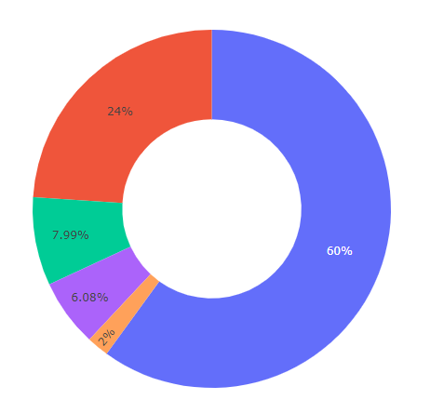
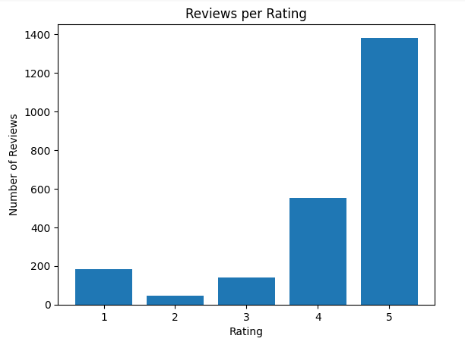
DATA VISUALIZATION

Slide 9
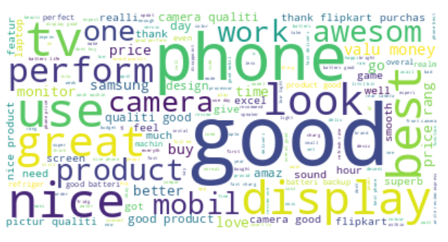
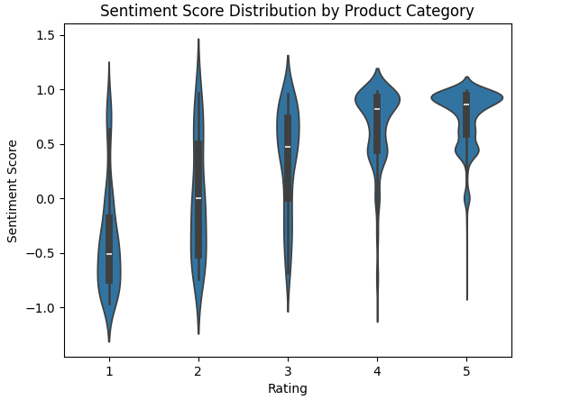

Slide 10
MODEL SELECTION
In Flipkart review sentiment analysis, a sentiment prediction model typically involves Natural Language Processing (NLP) techniques to classify reviews as positive, negative, or neutral.
NLTK Library for Sentiment Analysis
The NLTK (Natural Language Toolkit) library is one of the most popular Python libraries for natural language processing (NLP). It offers a wide range of tools to handle text preprocessing, tokenization, stemming, and also comes with pre-trained models for sentiment analysis. One of the most commonly used sentiment analysis tools in NLTK is the VADER (Valence Aware Dictionary and Sentiment Reasoner) model.

Slide 11
Models used for prediction in sentiment analysis is:
1.VADER-Valence Aware Dictionary and Sentiment Reasoner
It is a pre-trained model for sentiment analysis, especially tuned for social media text. It measures sentiment intensity across positive, negative, and neutral categories.
For product reviews (like Flipkart reviews), you can apply VADER to a dataset of reviews to analyze the sentiment of each review and get a sense of overall customer satisfaction.
2. Logistic Regression:
Logistic Regression is a common classification algorithm used in sentiment analysis when the task is to classify reviews as positive, negative, or neutral.
3.Support Vector Machine (SVM):
SVM is another model that can be used for sentiment classification. It aims to find the hyperplane that best separates positive, negative, and neutral reviews based on feature vectors generated from the text.SVM is often used when there is a need for a more robust model that can handle high-dimensional data such as text features from reviews.

Slide 12
Best Model Selection:
VADER is often selected as the best model for Flipkart review sentiment analysis due to its unique design tailored for social media and online text data, where brevity and emotive language are prevalent. Its lexicon-based approach allows it to effectively gauge sentiment from short, informal reviews, making it highly effective in capturing nuances like sarcasm and sentiment intensity. VADER's ability to process sentiment scores for various aspects of a review provides valuable insights, and its speed and efficiency make it suitable for real-time applications. Furthermore, it requires minimal preprocessing, which simplifies implementation compared to more complex models. Overall, VADER strikes an optimal balance between accuracy, interpretability, and ease of use, making it a preferred choice for sentiment analysis in e-commerce platforms like Flipkart.

Slide 13
Conclusion/Summary from the Flipkart Review Sentiment Analysis
By analyzing the sentiment scores of the Flipkart reviews using VADER, we can determine the general mood or sentiment of the customers.Using visualizations like the violin plot or bar charts of ratings and sentiment scores, we can see how the sentiment relates to the numerical ratings given by users. The sentiment analysis provides a quick, scalable way to understand thousands of customer reviews. This can help Flipkart or sellers gauge product reception, improve services, and cater better to customer expectations.
Overall,we can conclude that from above analysis most people have been given Neutral reviews, and a small proportion of people have given Negative reviews. So we can conclude that people are satisfied with Flipkart products and services.

Slide 14
THANK YOU

